Slide 1

Operating Systems Design Lab Session- 10
Understanding Shared Memory
System calls shmget(),shmat(),shmdt(),shmctl()
Program: lab10.1 - System V shared memory
Pthread library functions
Program: lab10.2 - Write a program to create 5 pthreads and display Hello world. Main thread should wait until all new threads are terminated.Use Simpler Argument Passing to a Thread

Slide 2
Understanding the Shared Memory
Shared memory is a memory shared between two or more processes
To reiterate, each process has its own address space, if any process wants to communicate with some information from its own address space to other processes, then it is only possible with IPC (inter process communication) techniques.
Create the shared memory segment or use an already created shared memory segment (shmget())
Attach the process to the already created shared memory segment (shmat())
Detach the process from the already attached shared memory segment (shmdt())
Control operations on the shared memory segment (shmctl())

Slide 3
#include <sys/ipc.h> #include <sys/shm.h> int shmget(key_t key, size_t size, int shmflg)
The first argument, key, recognizes the shared memory segment. The key can be either an arbitrary value or one that can be derived from the library function ftok(). The key can also be IPC_PRIVATE, means, running processes as server and client (parent and child relationship) i.e., inter-related process communiation. If the client wants to use shared memory with this key, then it must be a child process of the server. Also, the child process needs to be created after the parent has obtained a shared memory.
The second argument, size, is the size of the shared memory segment rounded to multiple of PAGE_SIZE.
The third argument, shmflg, specifies the required shared memory flag/s such as IPC_CREAT (creating new segment) or IPC_EXCL (Used with IPC_CREAT to create new segment and the call fails, if the segment already exists). Need to pass the permissions as well.
This call would return a valid shared memory identifier (used for further calls of shared memory) on success and -1 in case of failure. To know the cause of failure, check with errno variable or perror() function.

Slide 4
#include <sys/types.h>
#include <sys/shm.h>
void * shmat(int shmid, const void *shmaddr, int shmflg)
The first argument, shmid, is the identifier of the shared memory segment. This id is the shared memory identifier, which is the return value of shmget() system call.
The second argument, shmaddr, is to specify the attaching address. If shmaddr is NULL, the system by default chooses the suitable address to attach the segment. If shmaddr is not NULL and SHM_RND is specified in shmflg, the attach is equal to the address of the nearest multiple of SHMLBA (Lower Boundary Address). Otherwise, shmaddr must be a page aligned address at which the shared memory attachment occurs/starts.
The third argument, shmflg, specifies the required shared memory flag/s such as SHM_RND (rounding off address to SHMLBA) or SHM_EXEC (allows the contents of segment to be executed) or SHM_RDONLY (attaches the segment for read-only purpose, by default it is read-write) or SHM_REMAP (replaces the existing mapping in the range specified by shmaddr and continuing till the end of segment).
This call would return the address of attached shared memory segment on success and -1 in case of failure. To know the cause of failure, check with errno variable or perror() function

Slide 5
#include <sys/types.h> #include <sys/shm.h> int shmdt(const void *shmaddr)
The above system call performs shared memory operation for System V shared memory segment of detaching the shared memory segment from the address space of the calling process. The argument that needs to be passed is −
The argument, shmaddr, is the address of shared memory segment to be detached. The to-be-detached segment must be the address returned by the shmat() system call.
This call would return 0 on success and -1 in case of failure. To know the cause of failure, check with errno variable or perror() function.

Slide 6
#include <sys/ipc.h> #include <sys/shm.h> int shmctl(int shmid, int cmd, struct shmid_ds *buf)
The above system call performs control operation for a System V shared memory segment. The following arguments needs to be passed −
The first argument, shmid, is the identifier of the shared memory segment. This id is the shared memory identifier, which is the return value of shmget() system call.
The second argument, cmd, is the command to perform the required control operation on the shared memory segment.
The third argument, buf, is a pointer to the shared memory structure named struct shmid_ds. The values of this structure would be used for either set or get as per cmd.

Slide 7
#include <sys/types.h> #include <sys/ipc.h> key_t ftok(const char *pathname, int proj_id);
key_t ftok( const char *path, /* a path string */
int id /* an integer value */
);
Function ftok() takes a character string that identifies a path and an integer (usually a character) value, and generates an integer of type key_t based on the first argument with the value of id in the most significant position
After obtaining a key value, it can be used in any place where a key is required.
The place where a key is required accepts a special parameter, IPC_PRIVATE.

Slide 8
#include <stdio.h>
#include <stdlib.h>
#include <string.h>
#include <sys/types.h>
#include <sys/ipc.h>
#include <sys/shm.h>
#define SHM_SIZE 1024 /* make it a 1K shared memory segment */
int main(int argc, char *argv[])
{
key_t key;
int shmid;
char *data;
int mode;
if (argc > 2) {
fprintf(stderr,"usage: shmdemo [data_to_write]\n");
exit(1);
}
Program :
Shared memory for writer and reader process

Slide 9
/* make the key: */
if ((key = ftok("shm.c", 'R')) == -1)
{
perror("ftok");
exit(1);
}
/* connect to (and possibly create) the segment: */
if ((shmid = shmget(key, SHM_SIZE, 0644 | IPC_CREAT)) == -1)
{
perror("shmget");
exit(1);
}
/* attach to the segment to get a pointer to it:*/
data = shmat(shmid, (void *)0, 0);
if (data == (char *)(-1))
{ perror("shmat");
exit(1);
}

Slide 10
/* read or modify the segment, based on the command line: */
if (argc == 2)
{
printf("writing to segment: \"%s\"\n", argv[1]);
strncpy(data, argv[1], SHM_SIZE);
} else
{
printf("segment contains: \"%s\"\n", data);
/* detach from the segment: */
shmctl(shmid, IPC_RMID, NULL);
}
if (shmdt(data) == -1) {
perror("shmdt");
exit(1);
}
}

Slide 11
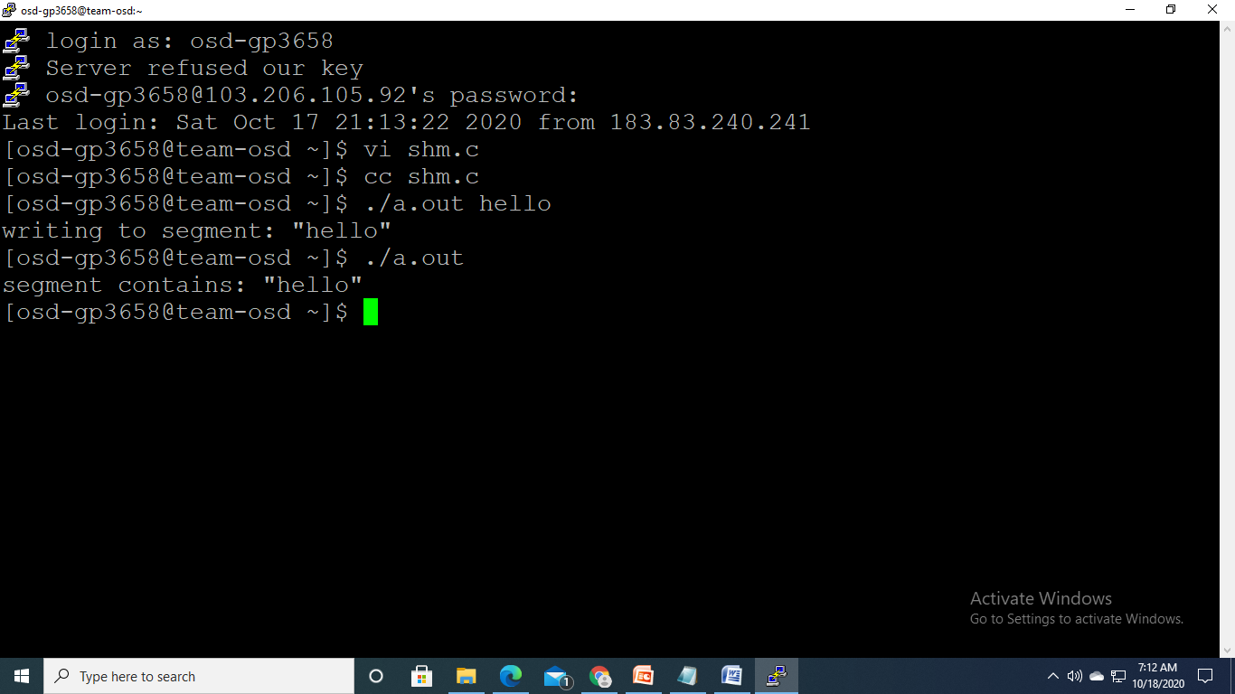

Slide 12
pthread library functions
1. pthread_create() :- create a new thread
Description : The pthread_create() function starts a new thread in the calling process. The new thread starts execution by invoking start_routine(); arg is passed as the sole argument of start_routine().
2. pthread_exit() :-terminate calling thread
Description : The pthread_exit() function terminates the calling thread and returns a value via retval that (if the thread is joinable) is available to another thread in the same process that calls pthread_join.
3.pthread_join() :-join with a terminated thread
Description : The pthread_join() function waits for the thread specified by thread to terminate. If that thread has already terminated, then pthread_join() returns immediately. The thread specified by thread must be joinable

Slide 13
.
4. pthread_self() :-obtain ID of the calling thread
Description : The pthread_self() function returns the ID of the calling thread. This is the same value that is returned in *thread in the pthread_create(3) call that created this thread.
5. pthread_cancel() :-send a cancellation request to a thread
Description : The pthread_cancel() function sends a cancellation request to the thread thread. Whether and when the target thread reacts to the cancellation request depends on two attributes that are under the control of that thread: its cancelability state and type.
6. pthread_detach( ):-detach a thread
Description : The pthread_detach() function marks the thread identified by thread as detached. When a detached thread terminates, its resources are automatically released back to the system without the need for another thread to join with the terminated thread.

Slide 14
7. pthread_equal() :-compare thread IDs
Description : The pthread_equal() function compares two thread identifiers.
8. pthread_mutex_init() :- initialise or destroy a mutex
Description : The pthread_mutex_init() function initialises the mutex referenced by mutex with attributes specified by attr . If attr is NULL, the default mutex attributes are used; the effect is the same as passing the address of a default mutex attributes object. Upon successful initialisation, the state of the mutex becomes initialised and unlocked.
9. pthread_mutex_destroy() :- destroy and initialize a mutex
Description : The pthread_mutex_destroy () function shall destroy the mutex object referenced by mutex ; the mutex object becomes, in effect, uninitialized. An implementation may cause pthread_mutex_destroy () to set the object referenced by mutex to an invalid value. A destroyed mutex object can be reinitialized using pthread_mutex_init (); the results of otherwise referencing the object after it has been destroyed are undefined.

Slide 15
10.pthread_mutex_lock() :- Lock a mutex
Description : The pthread_mutex_lock() function locks the mutex object referenced by mutex . If the mutex is already locked, then the calling thread blocks until it has acquired the mutex. When the function returns, the mutex object is locked and owned by the calling thread.
11. pthread_mutex_trylock() :- Attempt to lock a mutex
Description : The pthread_mutex_trylock() function attempts to lock the mutex mutex , but doesn't block the calling thread if the mutex is already locked.
12.pthread_mutex_unlock() :- Unlock a mutex
Description : The pthread_mutex_unlock() function unlocks the mutex mutex . The mutex should be owned by the calling thread. If there are threads blocked on the mutex then the highest priority waiting thread is unblocked and becomes the next owner of the mutex.

Slide 16
lab10.c
/* Program: lab.c -- Write a program to create 5 pthreads and display Hello world. Main thread should wait until all new threads are terminated. Use Simpler Argument Passing to a Thread. */

Slide 17
#include <stdio.h>
#include <pthread.h>
void* worker( void* p ) {
int* ip = (int*)p;
printf("Hello world from thread ID:%d,thread number %i!\n",pthread_self(),*ip);
}
int main() {
pthread_t OtherThread[4];
int i;
for(i=0;i<4;i++) {
pthread_create( &OtherThread[i], NULL, worker, &i );
sleep(1);
}
}

Slide 18
